Slide 1
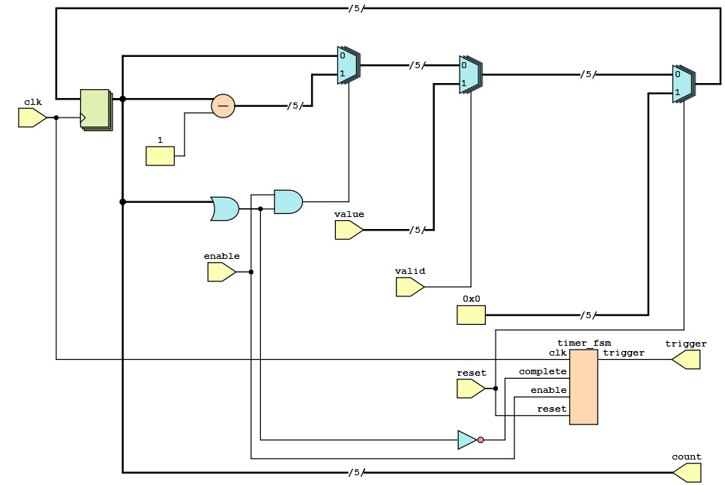
Analyzing a schematic for Verilog implementation. Start identifying the inputs and outputs!

Slide 2
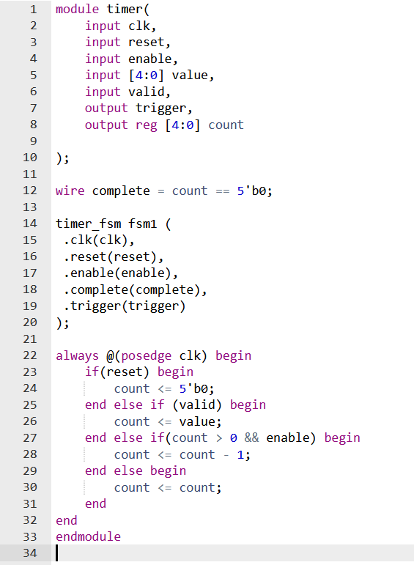
Analyzing a schematic for Verilog implementation. Start identifying the inputs and outputs! Inputs come in from the left, as we read from left to right:
clk
enable
value -> 5 bits wide!
valid
reset
Pay attention to the bit width of signals! Always assume a signals is 1 bit wide, unless otherwise indicated with /X/ notation on the signal!
e.g: The value input is 5 bits wide -> specified in Verilog as [4:0]

Slide 3
Analyzing a schematic for Verilog implementation. Start identifying the inputs and outputs! Outputs go out towards the right, opposing the inputs!
trigger
count -> 5 bits wide!
Pay attention to the bit width of signals! Always assume a signals is 1 bit wide, unless otherwise indicated with /X/ notation on the signal!
e.g: The count output is 5 bits wide -> specified in Verilog as [4:0]

Slide 4
Analyzing a schematic for Verilog implementation. Move on by including and connecting submodules!
timer_fsm
Inputs: (On the left)
clk
complete
enable
Reset
Outputs: (On the right)
trigger
We aren’t finished with the complete wire yet. What it is connected to is looked at in the next slides.

Slide 5
Analyzing a schematic for Verilog implementation. Now for the difficult part: Making sense of the LOGIC! But is it combinational or sequential logic?
Sequential! The logic circuit starts and ends in clock synchronized latches.
The difference between logic being combinational or sequential is of the utmost importance!
Use the clk signal to identify clock synchronized part of the logic!

Slide 6
Analyzing a schematic for Verilog implementation. Now for the difficult part: Making sense of the LOGIC! We see some logic gates but what are these other symbols? There is one subtractor and three chained multiplexors (MUX’s) The subtractor tells us this module must be counting down the count from the latches! The multiplexors determine what value of count propagates
Forgot your logic gates? Check the last slide!
Circuit designers are lazy and draw only that what is necessary. The OR-gate might be confusing, it only has one input, right? It actually has 5! The single draw input wire, count, is 5 bits wide. The OR-gate is or’ing all of the bits of count.
If the count is anything but 00000, the OR-gate will be 1. This OR-gate checks if the count is zero! The complete wire is the inverse (NOT-gated) of the OR-gate output. If count is 0, the OR-gate is 0 and complete is 1!

Slide 7
Analyzing a schematic for Verilog implementation. Now for the difficult part: Making sense of the LOGIC! The multiplexor chain is making decisions based on some values -> Its just an IF-Else statement! Look at the chain from back to front. Multiplexor A being last, can break the whole decision chain It is the first IF statement! Simply resetting the count on reset.
Multiplexors:
Have inputs on the left
A single output on the right
MUX (decide) based on the Top or Bottom inputs.

Slide 8
Analyzing a schematic for Verilog implementation. Now for the difficult part: Making sense of the LOGIC! The multiplexor chain is making decisions based on some values -> Its just an IF-Else statement! Look at the chain from back to front. Multiplexor B being next: Sets an external value into the count based on another external!
Multiplexors:
Have inputs on the left
A single output on the right
MUX (decide) based on the Top or Bottom inputs.

Slide 9
Analyzing a schematic for Verilog implementation. Now for the difficult part: Making sense of the LOGIC! The multiplexor chain is making decisions based on some values -> Its just an IF-Else statement! Look at the chain from back to front. Multiplexor C being last: Counts down the count if: enabled AND count is above zero! Else the count stays the same.
Multiplexors:
Have inputs on the left
A single output on the right
MUX (decide) based on the Top or Bottom inputs.

Slide 10
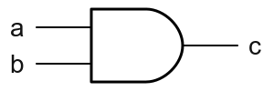
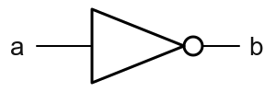
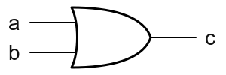
Analyzing a schematic for Verilog implementation. With that you have turned a schematic into Verilog!
Logic gates:
AND: c = a & b;
NOT: b = ~a;
OR: c = a | b;
XOR: c = a ^ b;

